Slide 1
Fundamentals of Python
For Artificial Intelligence

Slide 2
What is Python
Python is high-level general-purpose programming language used to create software, automate tasks, analyze data, build websites, develop AI/machine-learning models, and much more.
High Level
General-purpose programming language

Slide 3
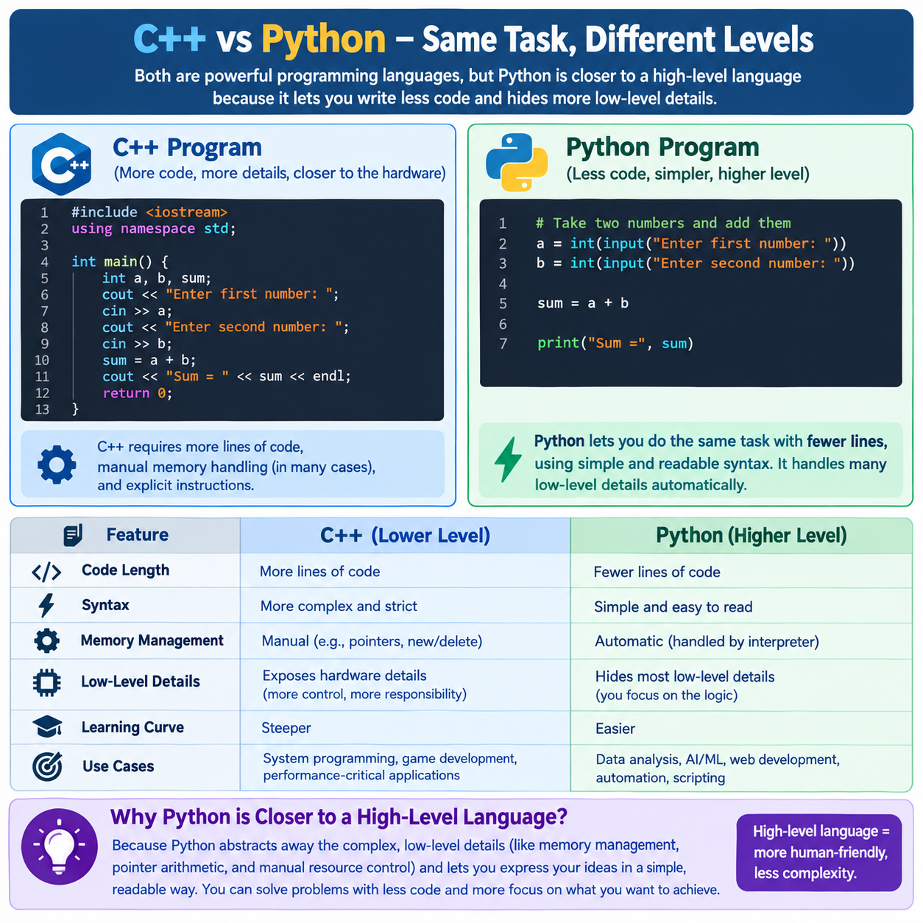
Why Python Is Considered a High-Level Language

Slide 4
Variables
A variable is a name used to store a value.
name = "Usama"
age = 25
Salary = 35000
We can later use these variables to print values using print function.
Python automatically determines the type. (dynamically typed)
This is one reason Python feels simpler and more human-friendly.

Slide 5
Operators in python
Arithmetic Operators
+
-
/
//
%
**

Slide 6
Comparison Operator & Assignment Operators
x > y 1) =
x < y 2) +=
x == y 3) -=
x != y
x >= y
x <=y

Slide 7
Python Logical Operators: and, or, not
These operators are used with True/False conditions.
AND (and returns True only when both conditions are True.)
OR (or returns True when at least one condition is True.)
NOT (not reverses the result.)

Slide 8
Type Casting vs Type Conversion in Python
Type Conversion:
Type conversion means changing a value from one data type to another, usually using Python's built-in functions.
x = "10" y = int(x)
Type Casting:
Type casting usually refers to explicitly forcing a value into a particular type.

Slide 9
Input in Python
The input() function is used to take data from the user while the program is running.
Input(“Enter Your name”)

Slide 10
String
A string is a sequence of characters (text) enclosed in **single quotes ' ' or double quotes " ".
Methods to initialize String
‘’ , “”, “”” “””

Slide 11
String Functions in Python
len() Finds the number of characters in a string.
upper() Converts the string to uppercase.
Lower() Converts the string to lowercase.
capitalize() Makes the first character uppercase.
title() Makes the first letter of each word uppercase.
strip() Removes spaces from the beginning and end.
replace() Replaces one piece of text with another.
find() Finds the position (index) of a substring.
count() Counts how many times something appears.
split() Splits a string into a list.
join() Joins items together into a string.

Slide 12
Indexing and Slicing
Indexing:
Indexing means accessing a single character from a string.
P Y T H O N
0 1 2 3 4 5
str[2]=?
Slicing:
Slicing means extracting a part of a string.The start index is included, but the end index is not included.
Different Slicing Example:
print(text[1:4])
print(text[2:5])
print(text[:3])
print(text[3:])
print(text[:])

